Slide 1
Why Study Climate?
Hydrology as we know it is driven by the climate, primarily precipitation, but also temperature and radiation. To understand the variability in hydrology we need to understand climate.

Slide 2
Climate prediction is coming of age?
El Nino
+ Southern Oscillation
= ENSO
Man induced climate change
Impacts on Water Resources may be significant
Changed Climate
Advanced Warning

Slide 3
Goal?
A basic quantitative understanding of how the global climate system works, to allow informed assessment of climate based forecasts and their role in hydrology and water resources systems.

Slide 4
Learning Objectives
You should be able to quantify the energy balance of the earth and the greenhouse effect
You should be able to quantify the latitudinal distribution of energy fluxes at the earth surface
You should be able to describe the general circulation of the atmosphere and how this relates to the hydrologic cycle and the distribution of hydrologic processes on the earth
You should be able to describe El Nino Southern Oscillation (ENSO) and how it relates to hydrology
You should be able to quantify the broad hydro climatological water balance at a location of interest
You should be able to apply holistic energy and mass balance analysis to examine the sensitivity of climate and hydrologic processes to changes in inputs

Slide 5
Overview
Solar Radiation
Atmospheric effect on radiation (Greenhouse effect)
Latitude and Seasons
Global Circulation patterns
Weather and Climate
Teleconnections (ENSO)
The distribution of hydrologic variables

Slide 6
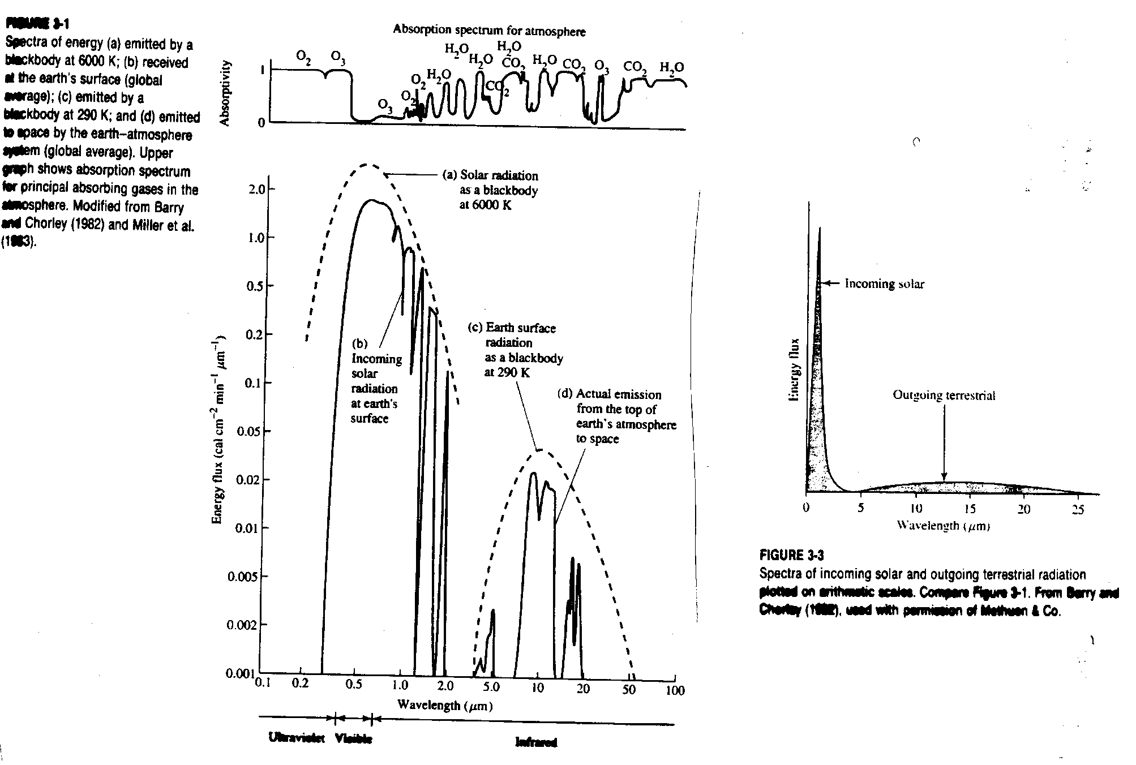
Incoming and Outgoing Energy Spectra
linear-scale
log-scale
From Dingman, 2002

Slide 7
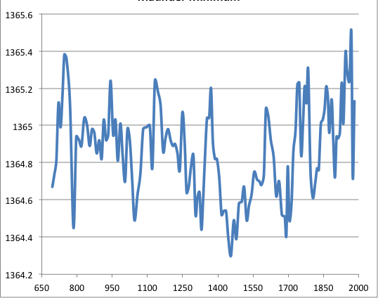
Total Solar Irradiance (W/m²) reconstructed data
W/m²
Year AD
Slide from Simon Wang
Source: Delaygue and Bard (2010)

Slide 8
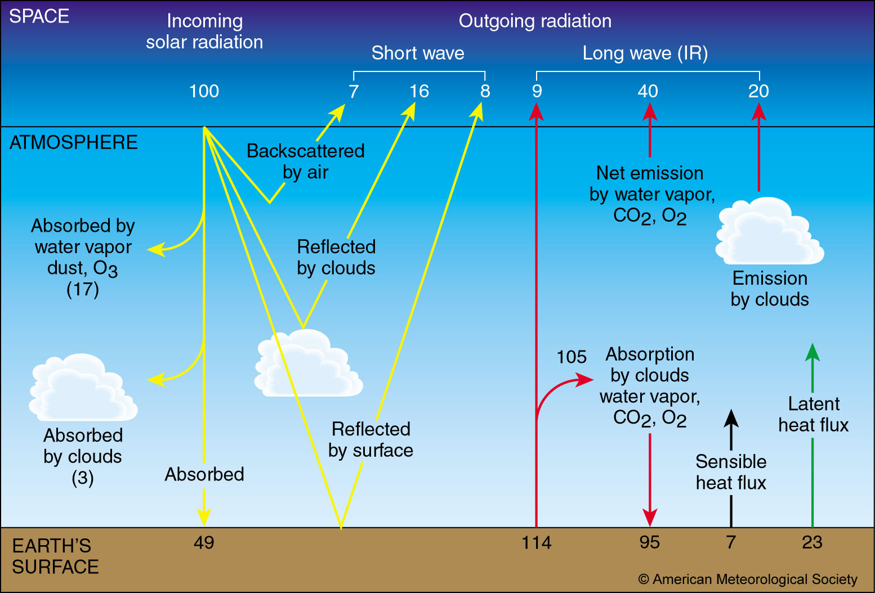
Global Energy Balance
Slide from Simon Wang

Slide 9
World Water Balance
From Brutsaert, 2005

Slide 10
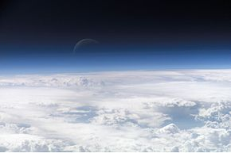
Two layer atmosphere energy balance
W
Refer to Box 3-2 for definitions of quantities and numerical estimates of parameters

Slide 11
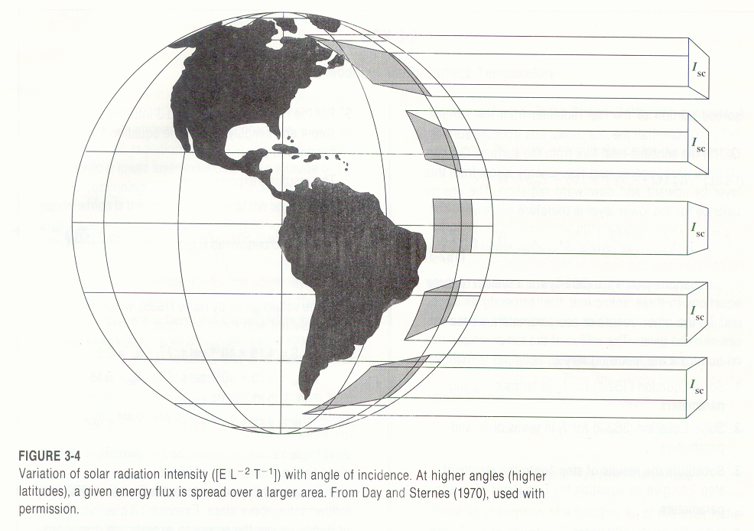
From Dingman, 1994

Slide 12



Atmosphere
Energy flux
(transport)
Energy flux
(transport)
Slide from Simon Wang

Slide 13
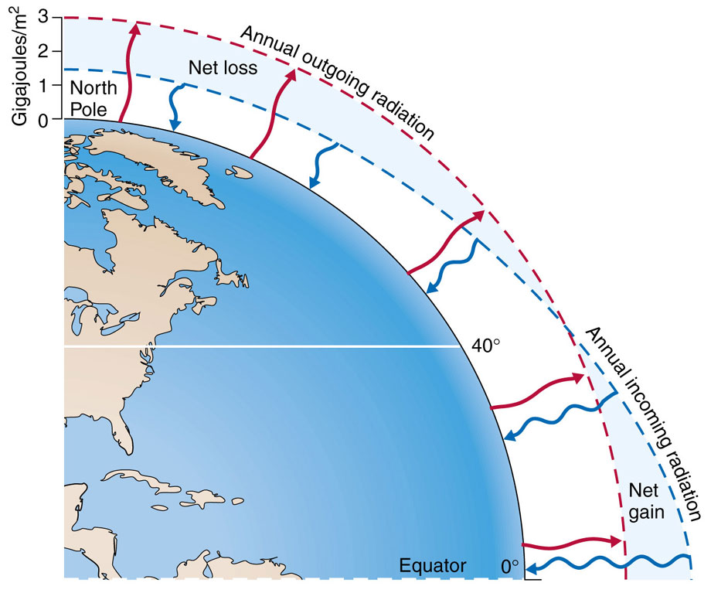
Slide from Simon Wang

Slide 14
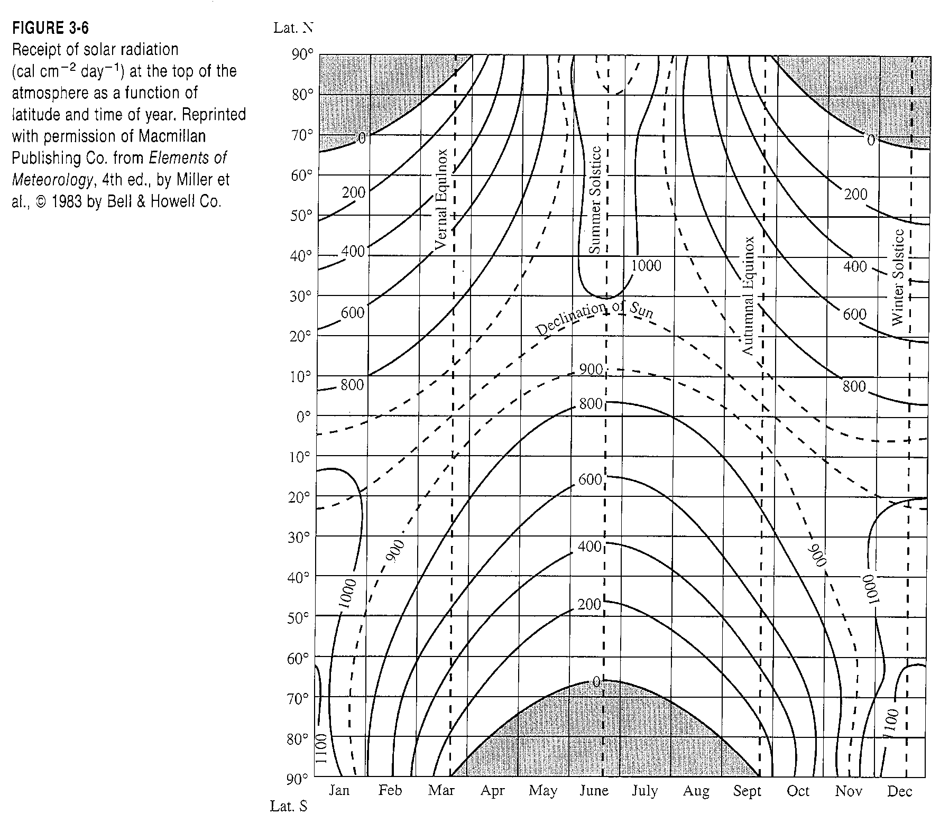
From Dingman, 1994

Slide 15
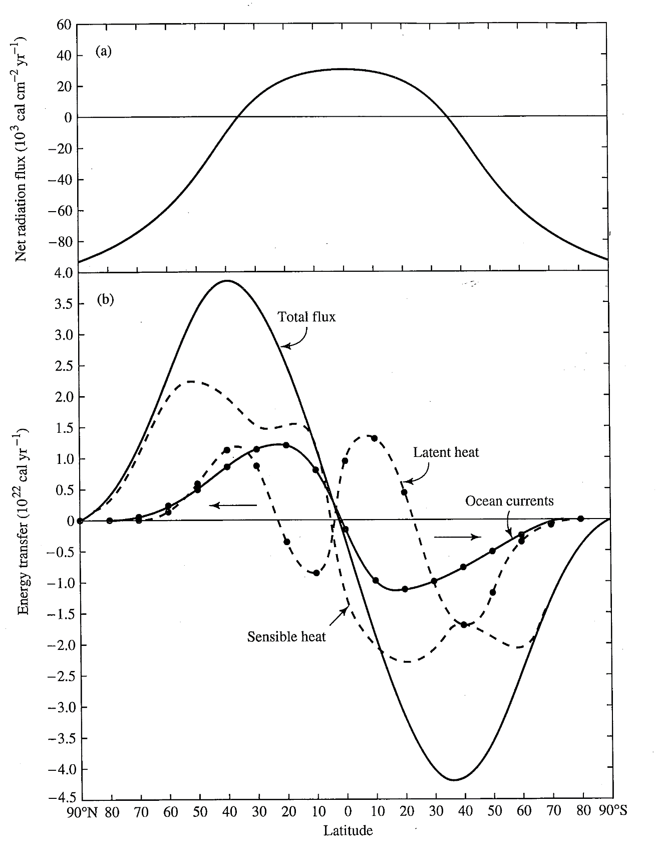
From Dingman, 1994

Slide 16
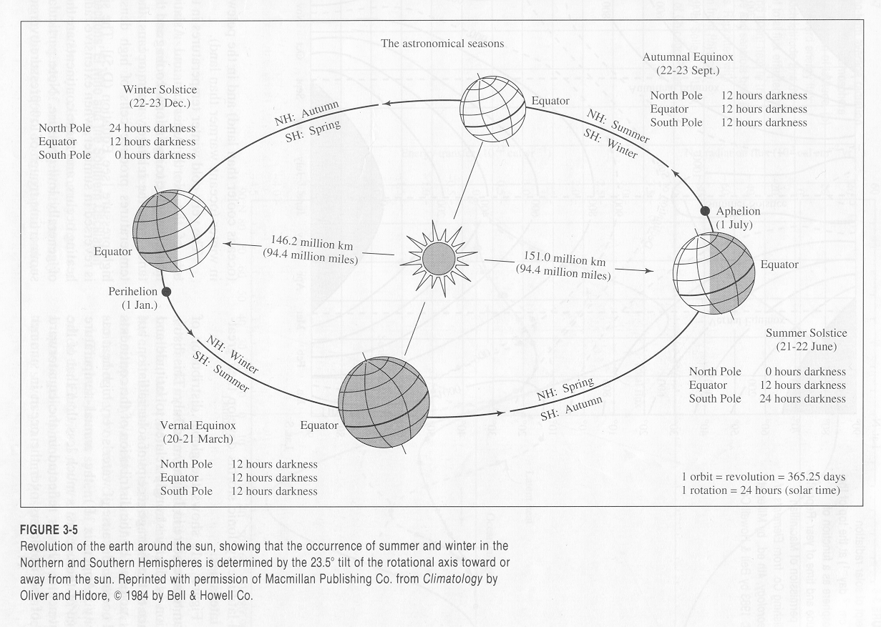
From Dingman, 1994

Slide 17
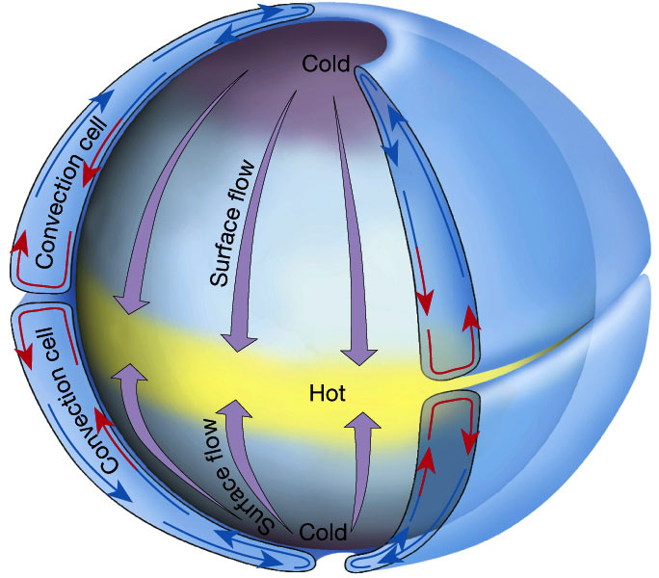

Single-Cell Model
A rotating Earth would introduce [ what ] force?
Slide from Simon Wang

Slide 18
Coriolis Effect
http://www.youtube.com/watch?v=_36MiCUS1ro&feature=related

Slide 19
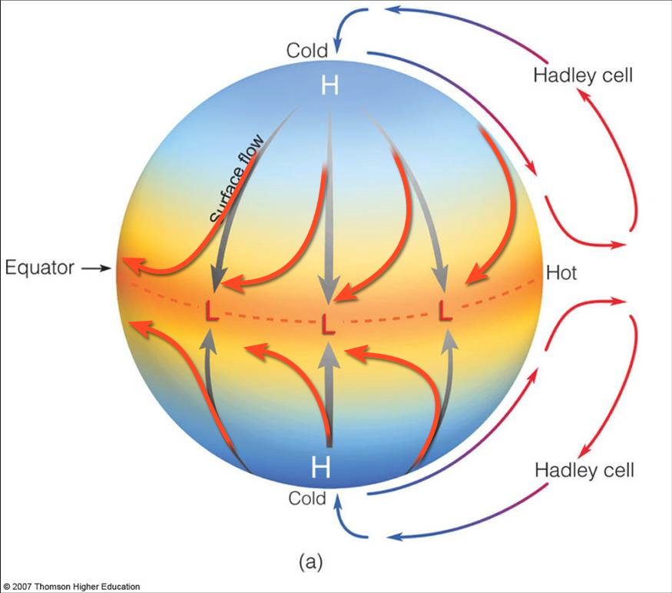
Single-Cell Model:
Explains why there are
tropical easterlies
(trade winds)
“Ideal Hadley Cell (Model)”
Slide from Simon Wang

Slide 20
Single-Cell Model:
But there is a problem…
Upper-level winds
“Ideal Hadley Cell (Model)”
Slide from Simon Wang

Slide 21
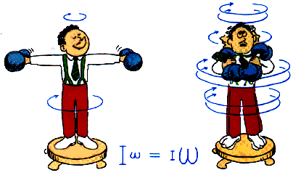
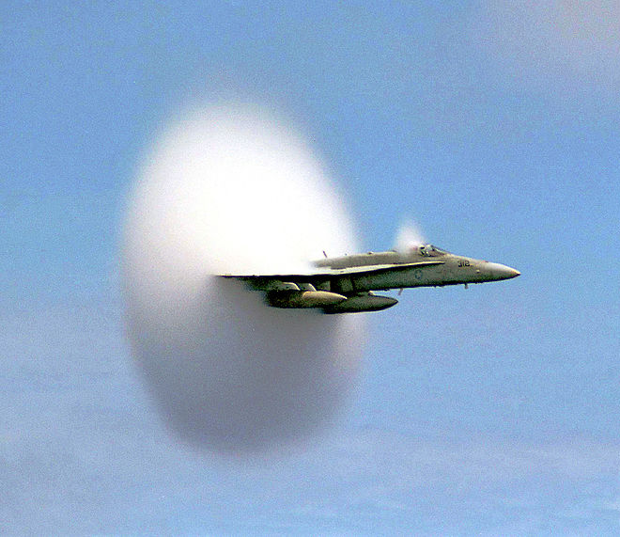
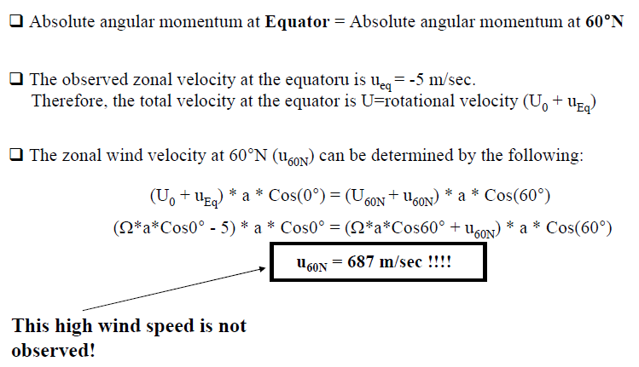
Single-Cell Model:
The problem is…
Speed of sound: ~ 330 m/sec
Slide from Simon Wang

Slide 22
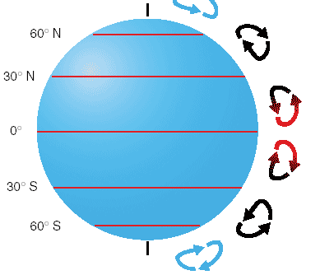
Single-Cell Model → Three-Cell Model
Taking Coriolis
force into account
Upper-level winds
~100 km/hr
(or 60 mph)
Slide from Simon Wang

Slide 23
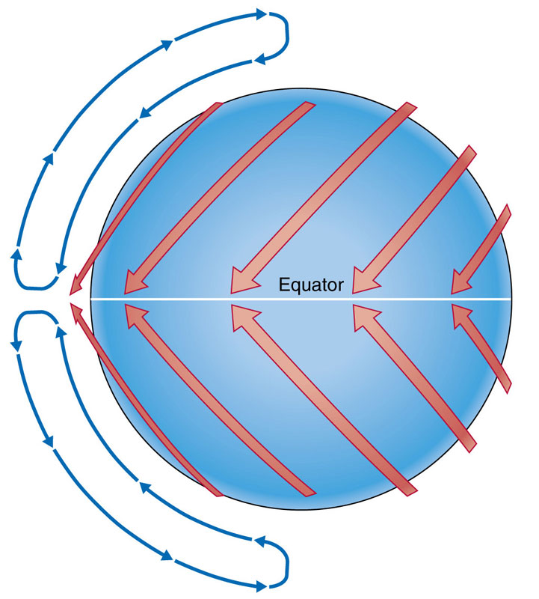
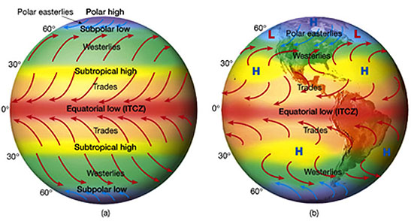
Single-Cell Model → Three-Cell Model
Continent-Ocean
(topographical) influences
Slide from Simon Wang

Slide 24
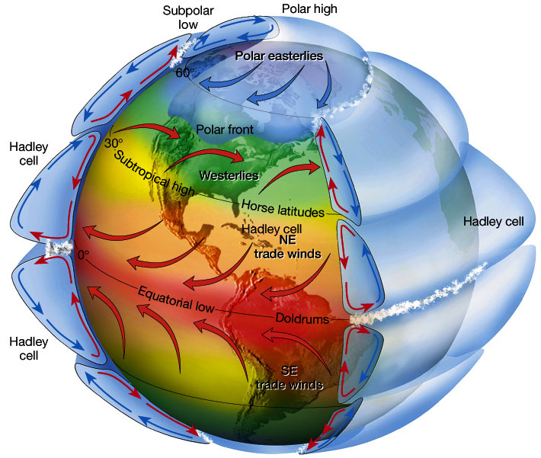
Three-Cell Model
Slide from Simon Wang

Slide 25
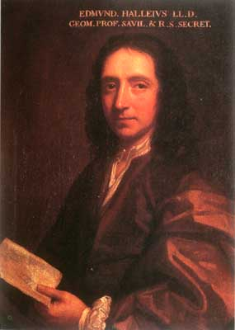
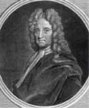
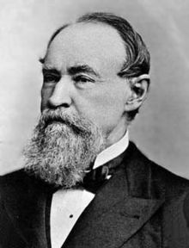
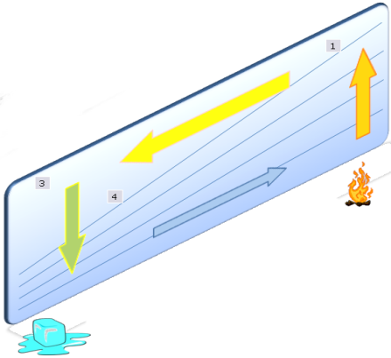


Three-Cell Model: Scientific evolution
Halley
Hadley
Ferrel
Thermally direct
circulation forcing
air towards equator
Earth’s rotation and
the conservation of
linear momentum
cause the Trade Winds
Coriolis force deflects
winds toward the east
and pulls air from south
+ Conservation of
angular momentum
170 years!
Slide from Simon Wang

Slide 26
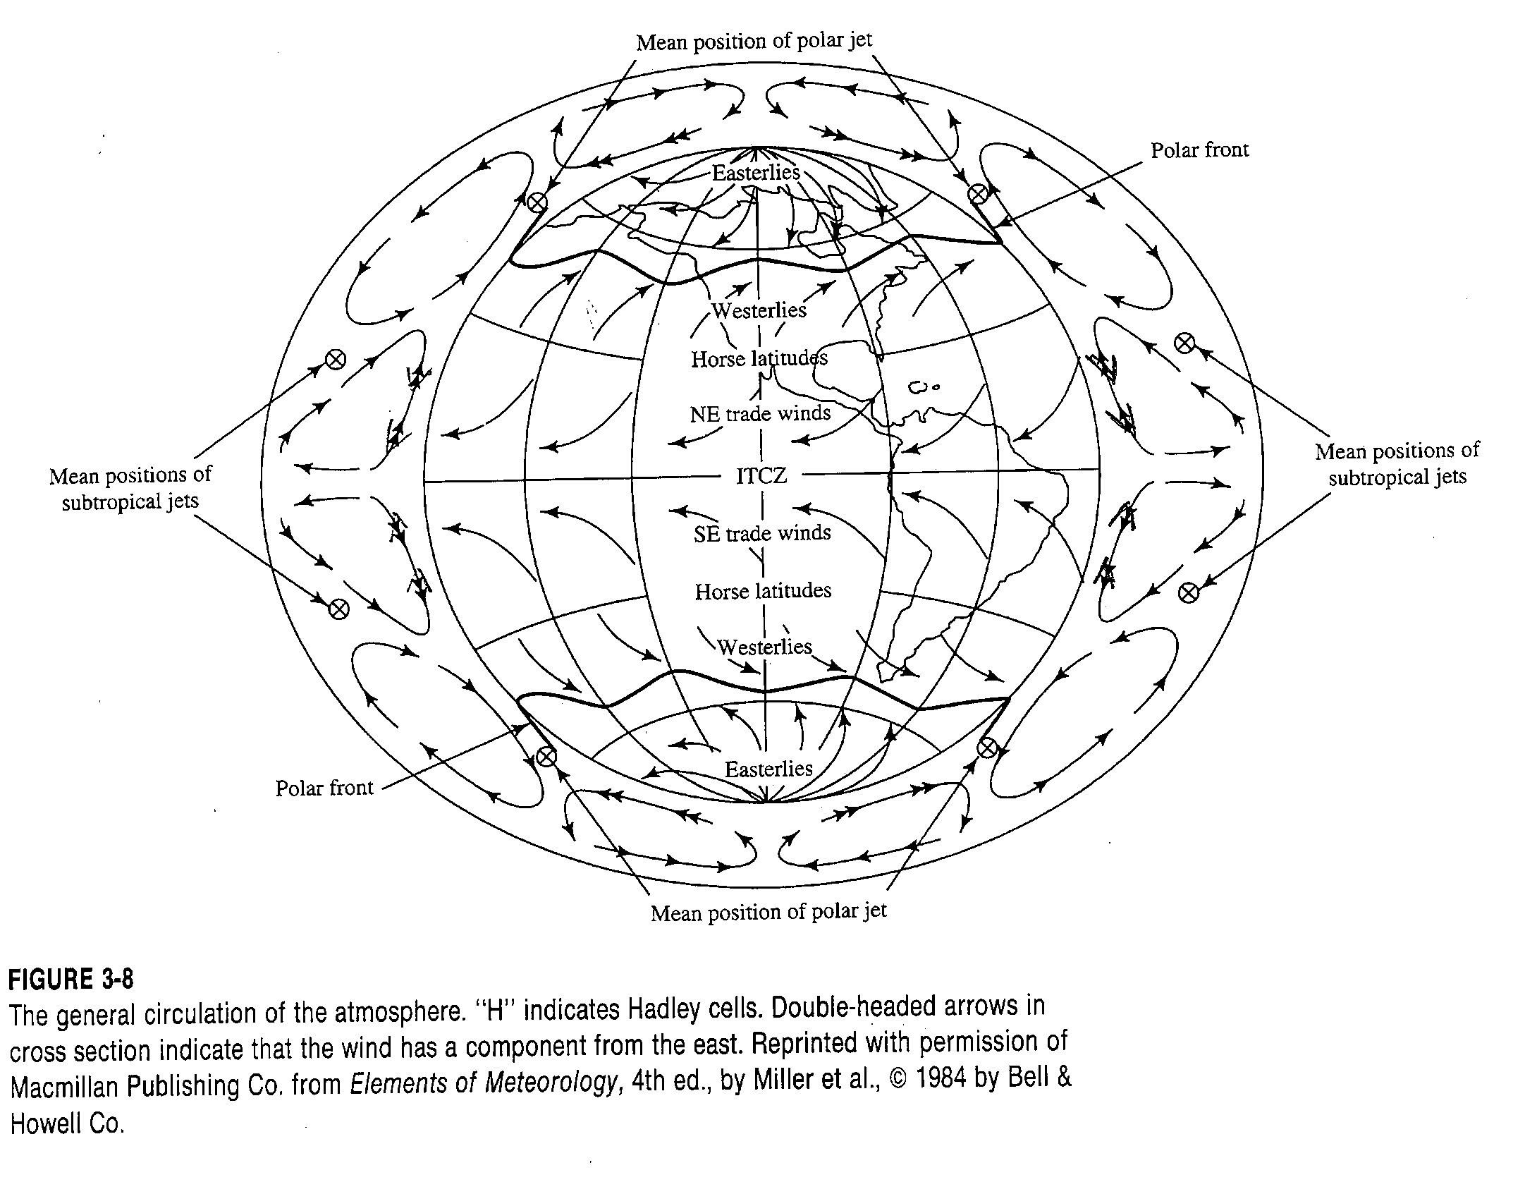
From Dingman, 1994

Slide 27
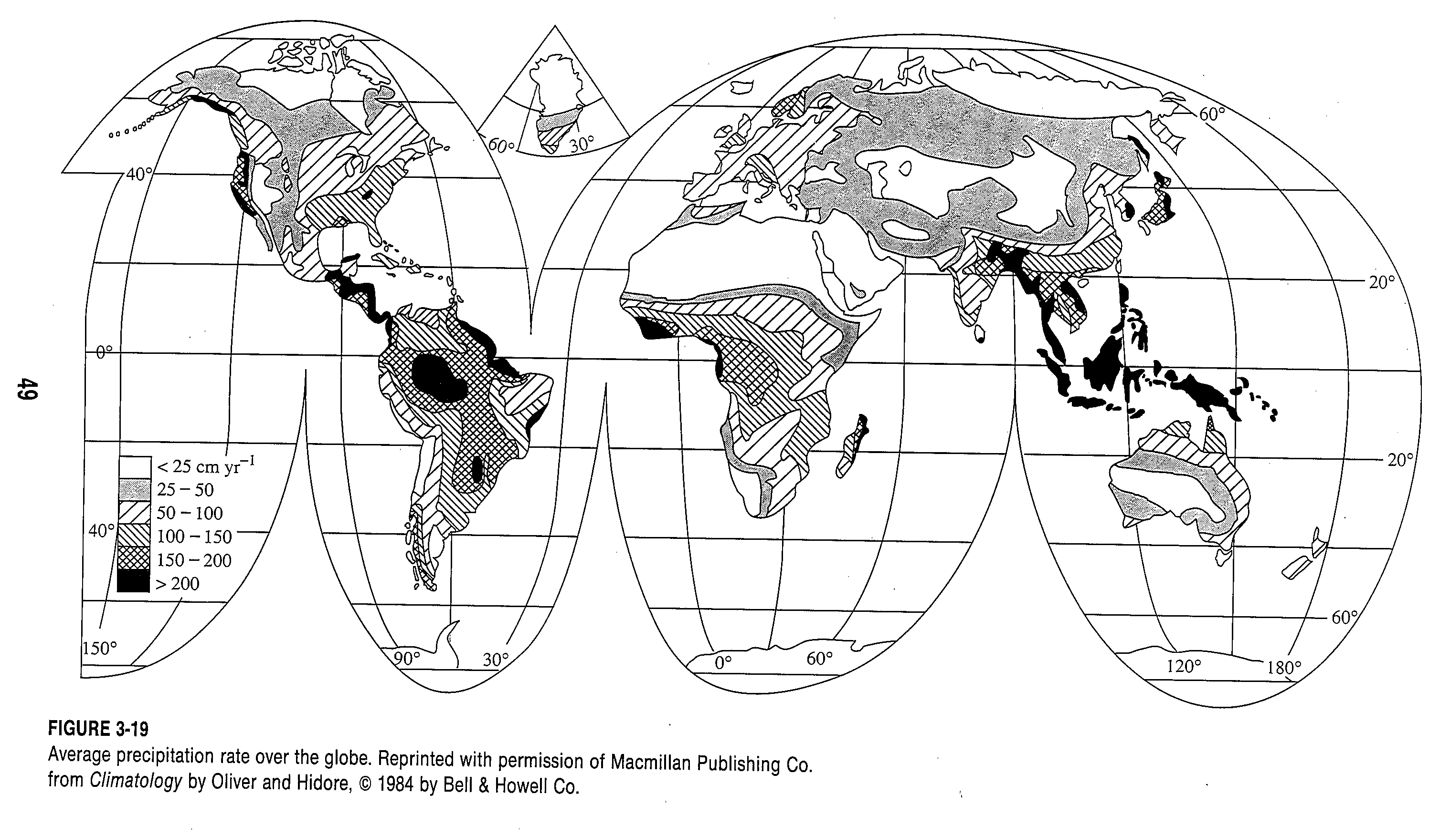
From Dingman, 1994

Slide 28
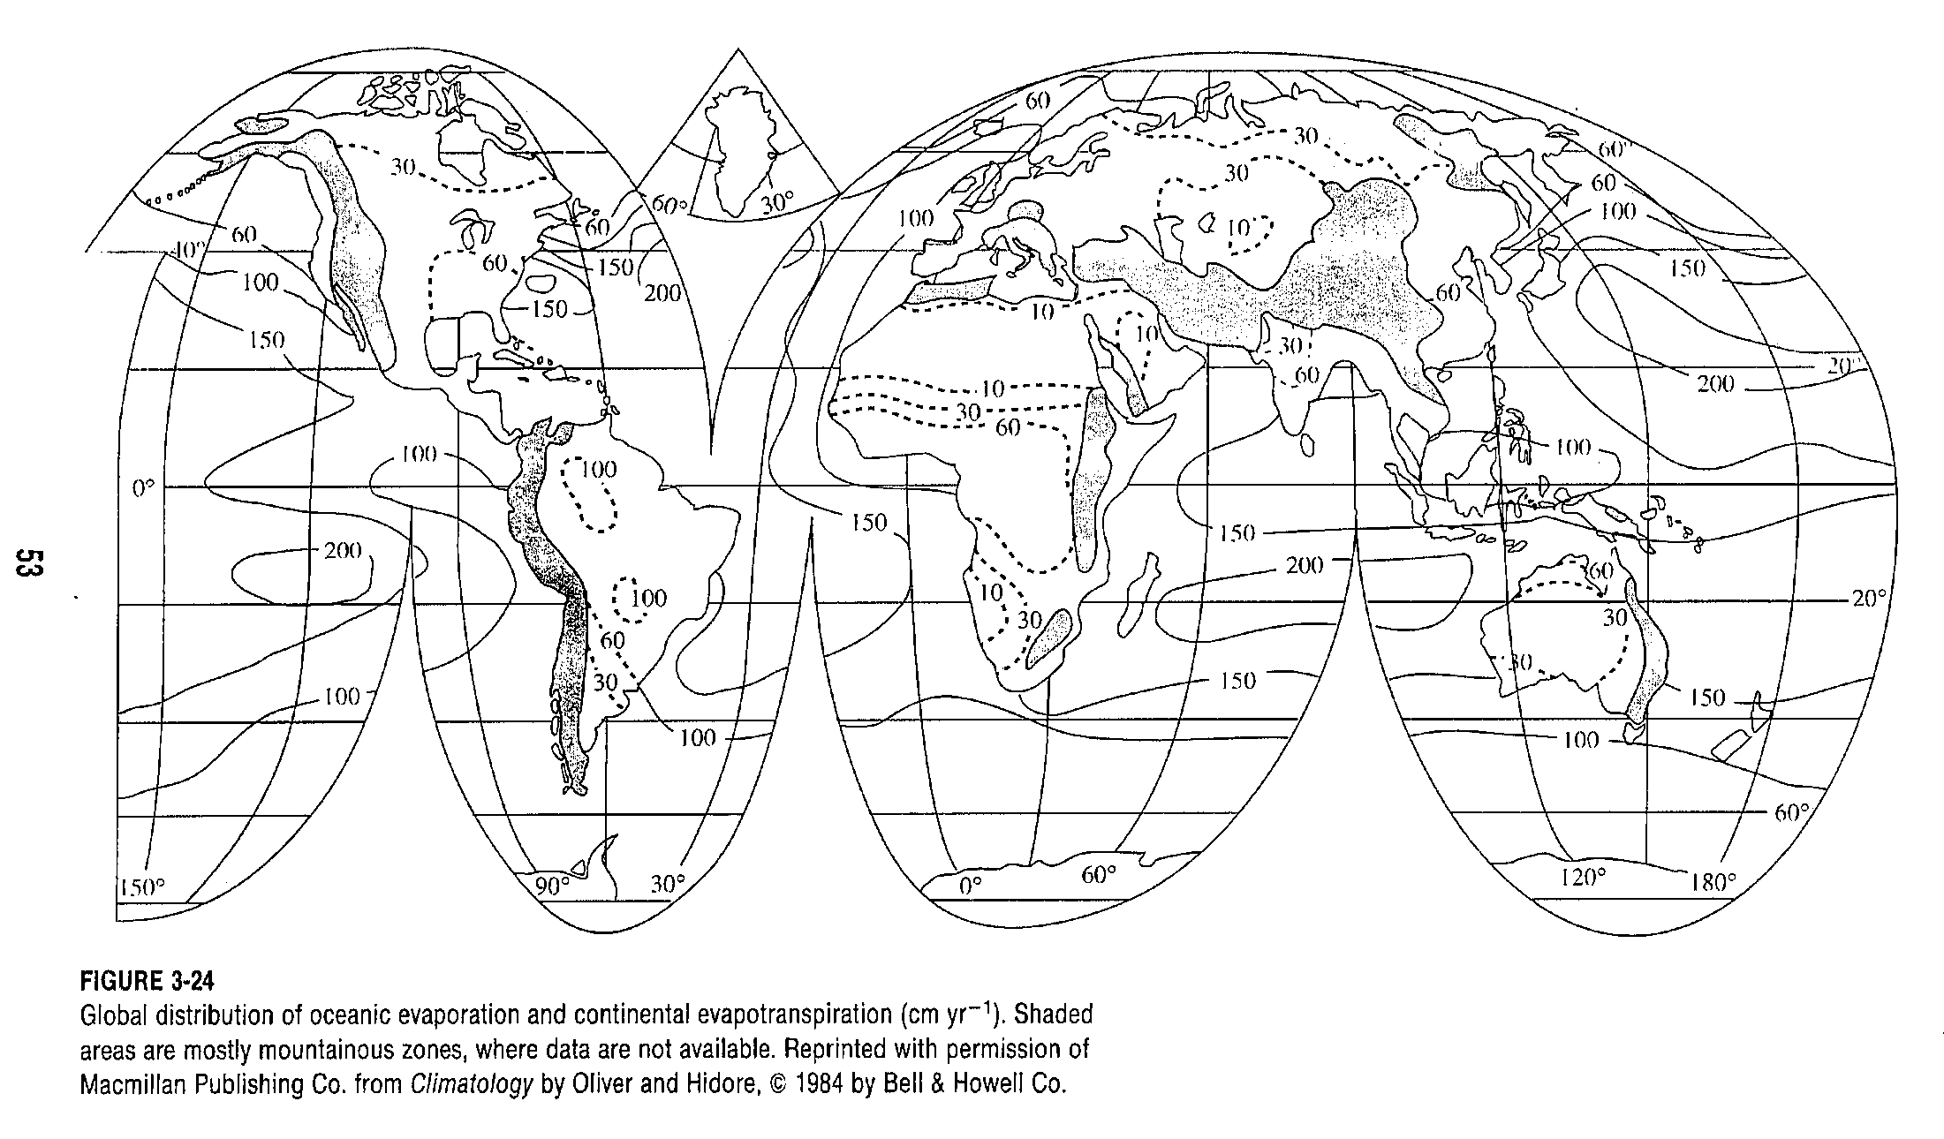
From Dingman, 1994

Slide 29
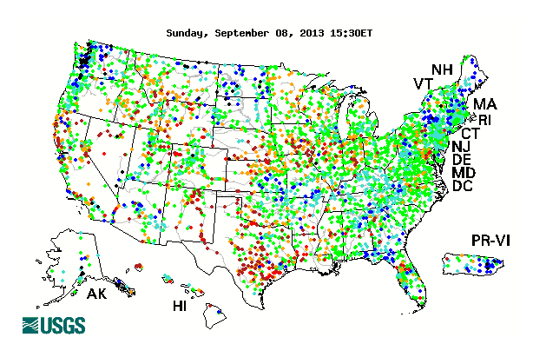
Streamflow data
http://waterwatch.usgs.gov/
http://waterdata.usgs.gov/nwis

Slide 30
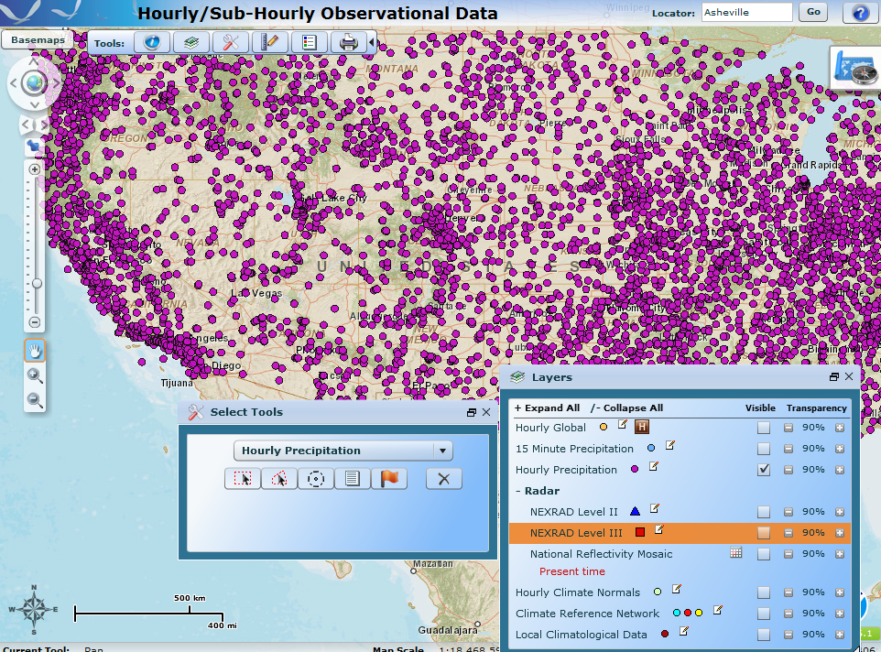
Precipitation Data
http://www.climate.gov/maps-data
http://gis.ncdc.noaa.gov/map/viewer/#app=clim&cfg=cdo&theme=hourly&layers=001&node=gis

Slide 31
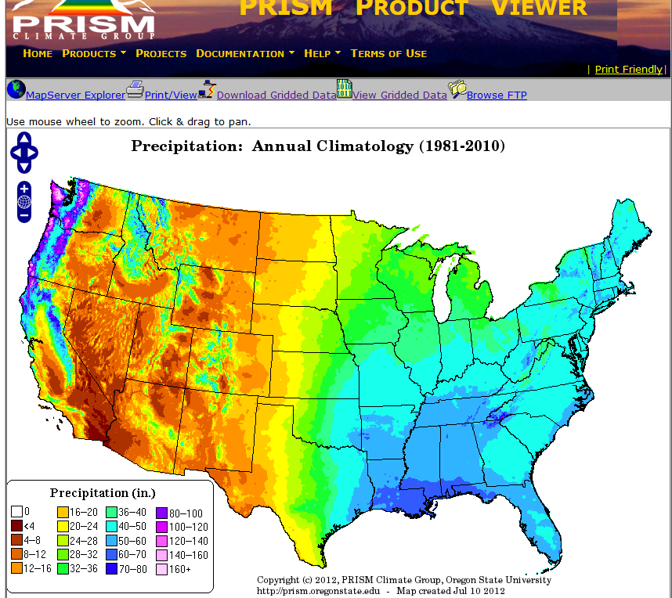
PRISM Precipitation data
http://www.prism.oregonstate.edu/

Slide 32
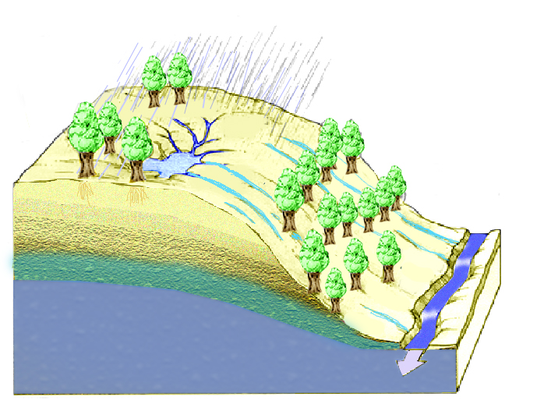
Water Balance Equation
P
E
P=Q+E
Q=P-E
∆S=P-Q-E
∆S
Q

Slide 33
P=Q+E
E=P
E
Q
E=Ep
E
P

Slide 34
P=Q+E
E=P
E
Q
E=Ep
W=Q/P 1
E
P
W=Q/P 0

Slide 35
Rearranged with Aridity Index axes
E/P
E=Ep
Energy limited upper bound
E=P
Water limited upper bound
1
Evaporative Fraction
Q/P
Budyko, 1974
Humid
Arid
Ep/P
Energy Limited
Water Limited
Dryness (Available Energy /Precip)

Slide 36
E/P=ϕ(R/P) Budyko, 1974
E/P
1
Evaporative Fraction
ν ≈ 2
Dryness (Available Energy/Precip)
R/P

Slide 37
Some examples from Utah
ID | Watershed
1302 | West Canyon Creek near Cedar Fort
1402 | White River Below Tabbyune Creek
2102 | Yellowstone River near Altonah
2104 | Duchesne River near Tabiona

Slide 38
What else controls the water balance partition function (Budyko curve)?
E/P
Soil Storage/ Retention or Residence time
E = R : energy limited upper bound
large
medium
small
1
E = P : water limited upper bound
Evapotranspiration fraction
Theoretical functional form
f(R/P, S/(Pτ))
R/P
humid
arid
energy limited
water limited
Dryness (available energy /precip)

Slide 39
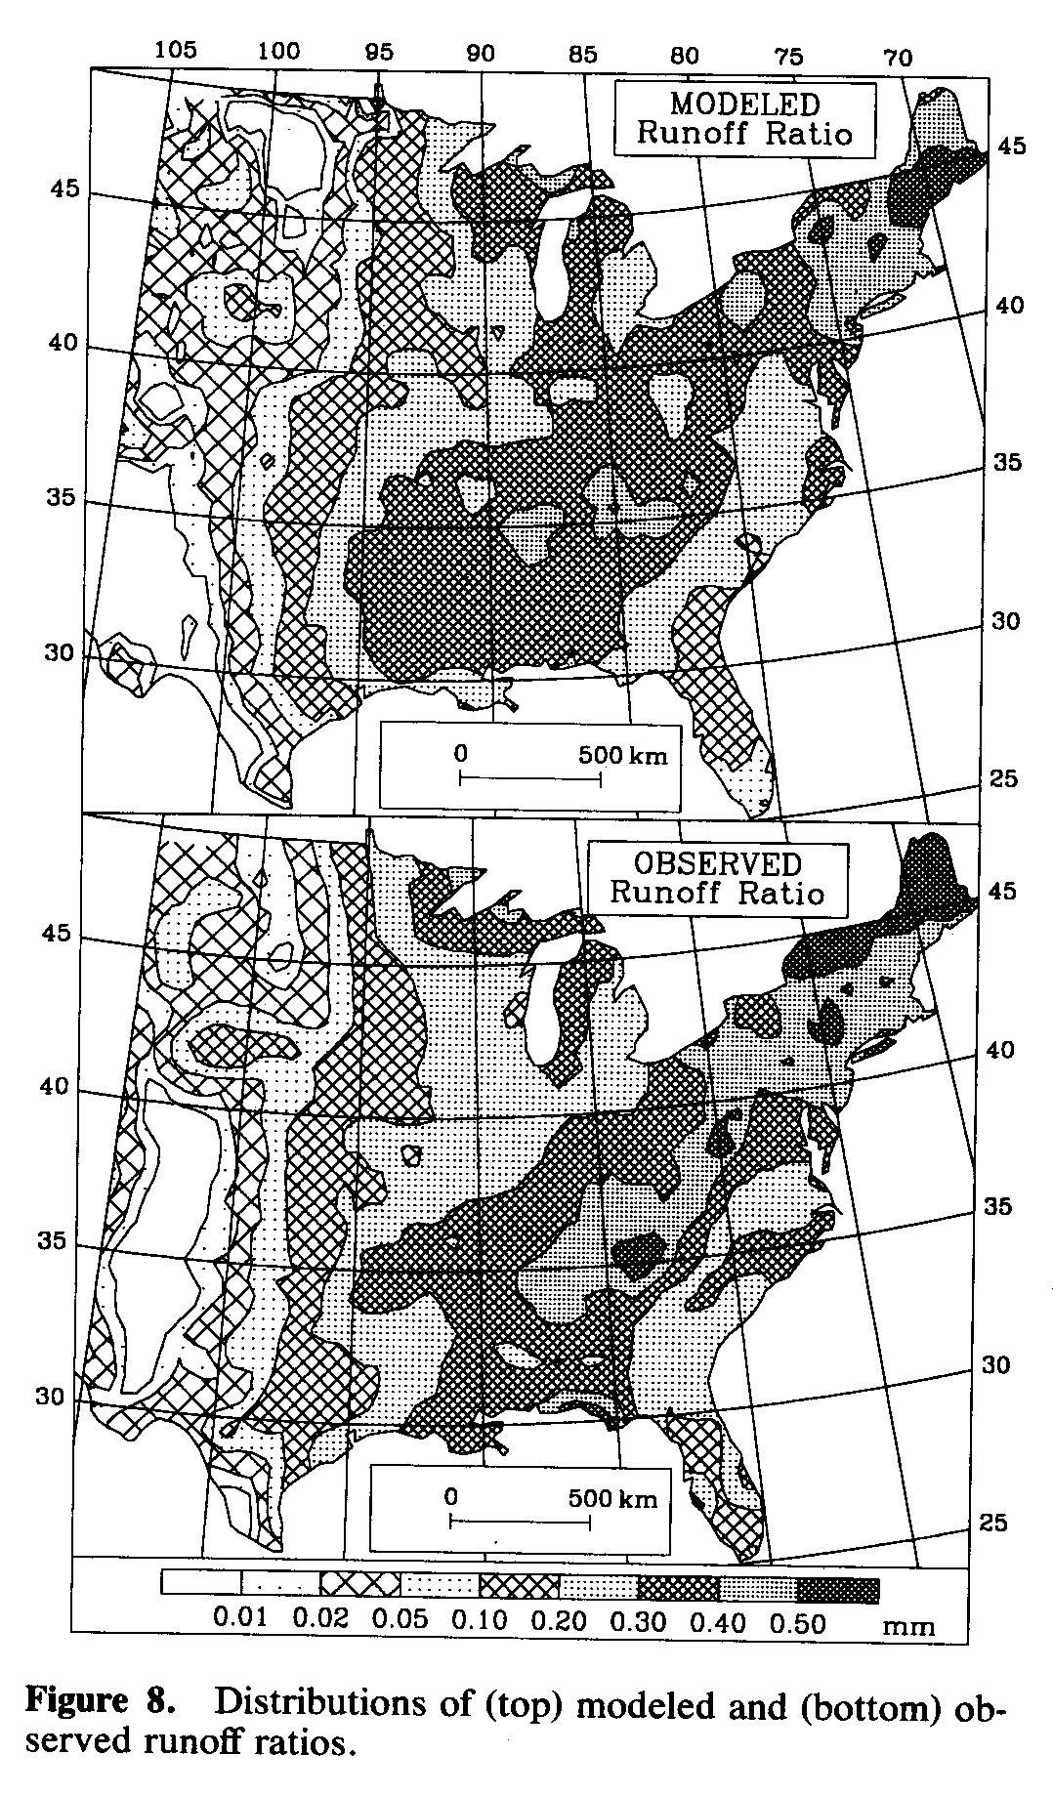
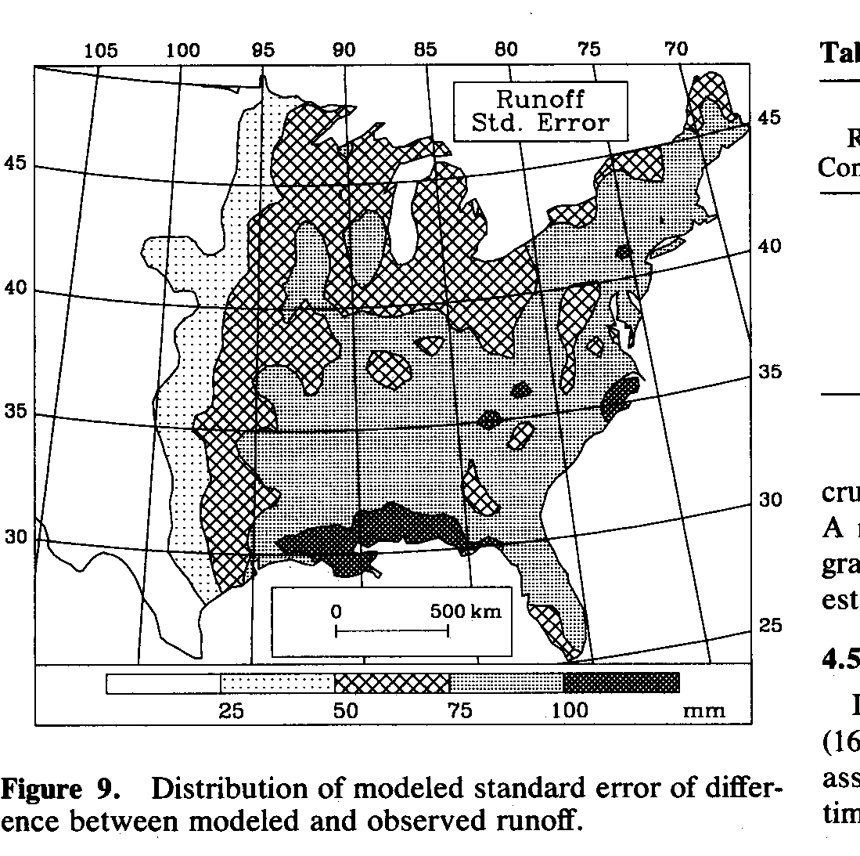
Uncalibrated Runoff Ratio
Explains 88% of geographic variance
Remaining 12% difference is consistent with uncertainty in model input and observed runoff
Low
High
Milly, P. C. D., (1994), "Climate, Soil Water Storage, and the Average Annual Water Balance," Water Resources Research, 30(7): 2143-2156.

Slide 40
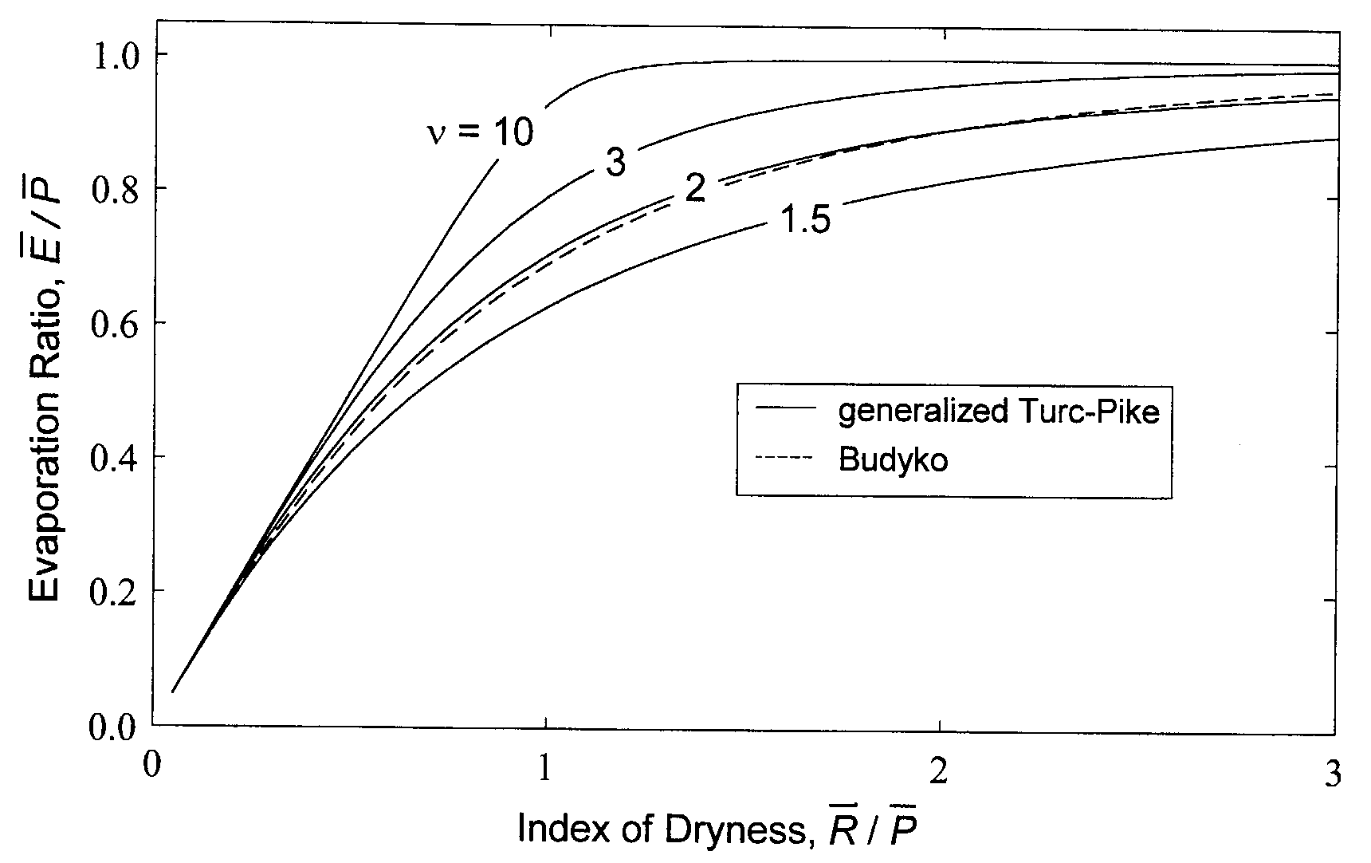
Milly/Budyko Model – Framework for predictions hypothesis testing
Q/P
Increasing variability in soil capacity or areas of imperviousness
Increasing Retention or Soil capacity
Increasing variability in P – both seasonally and with storm events
Milly, P.C.D. and K.A. Dunne, 2002, Macroscale water fluxes 2: water and energy
supply control of their interannual variability, Water Resour. Res., 38(10).

Slide 41
From Dingman, 1994

Slide 42

El Niño what used to be a local feature has turned into a global phenomenon
Teleconnections
Slide from Simon Wang

Slide 43
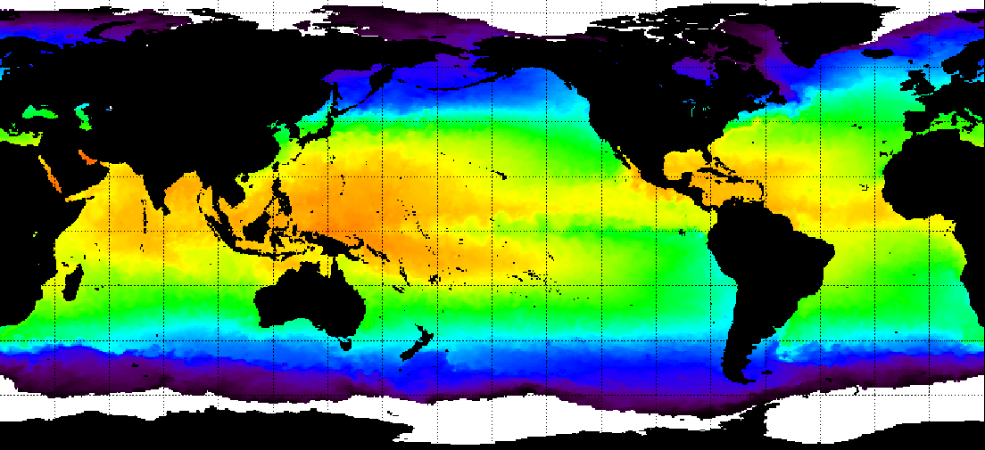
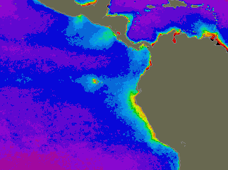
Sea surface temperature
warm
surface chlorophyll content
Ekman spiral
Costal upwelling
← high productivity
Nimbus 7 satellite
Slide from Simon Wang

Slide 44
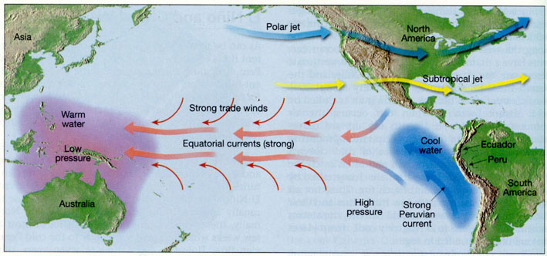
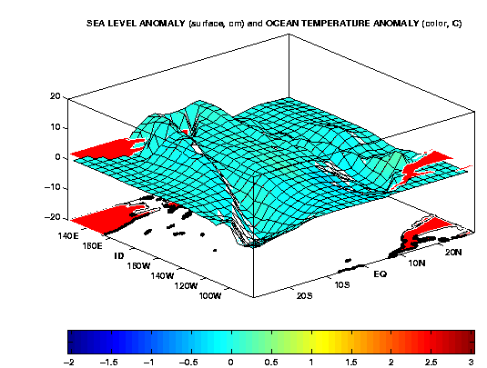
→ affects
air pressure
Slide from Simon Wang

Slide 45
El Niñ﻿o: local phenomenon → regional → global !! → “coupled” mode
Slide from Simon Wang

Slide 46
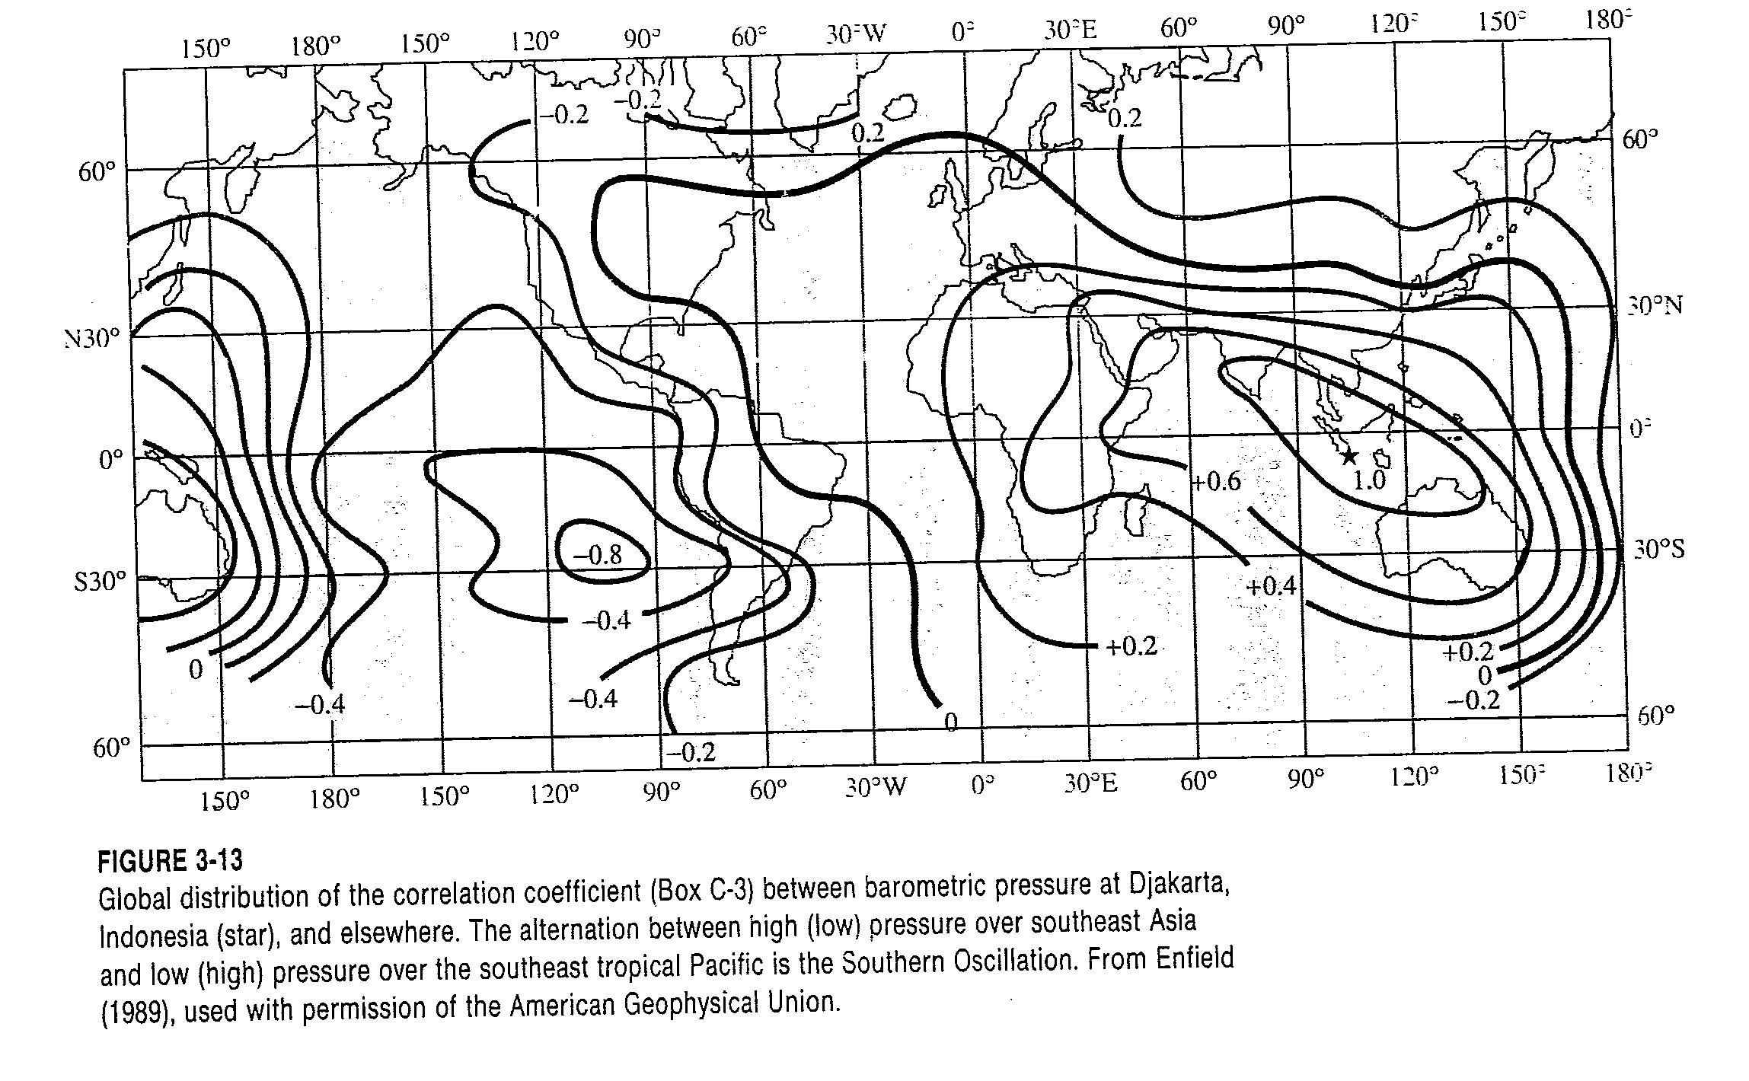
From Dingman, 1994

Slide 47
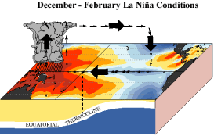
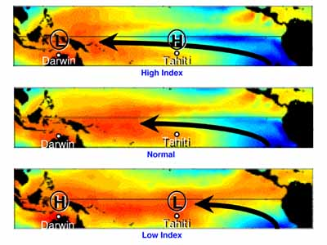
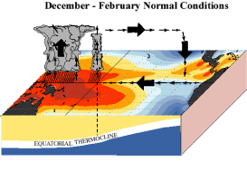
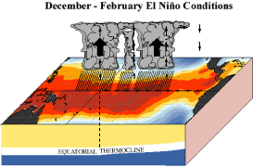
ENSO Model
Slide from Simon Wang

Slide 48
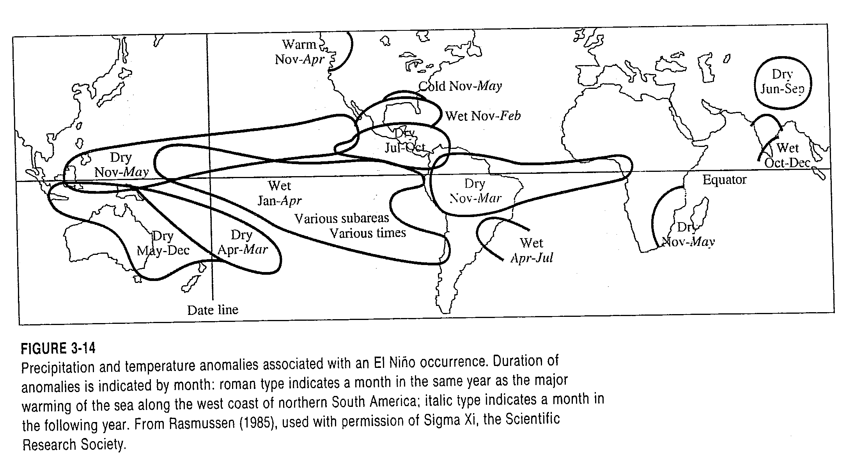
From Dingman, 1994

Slide 49
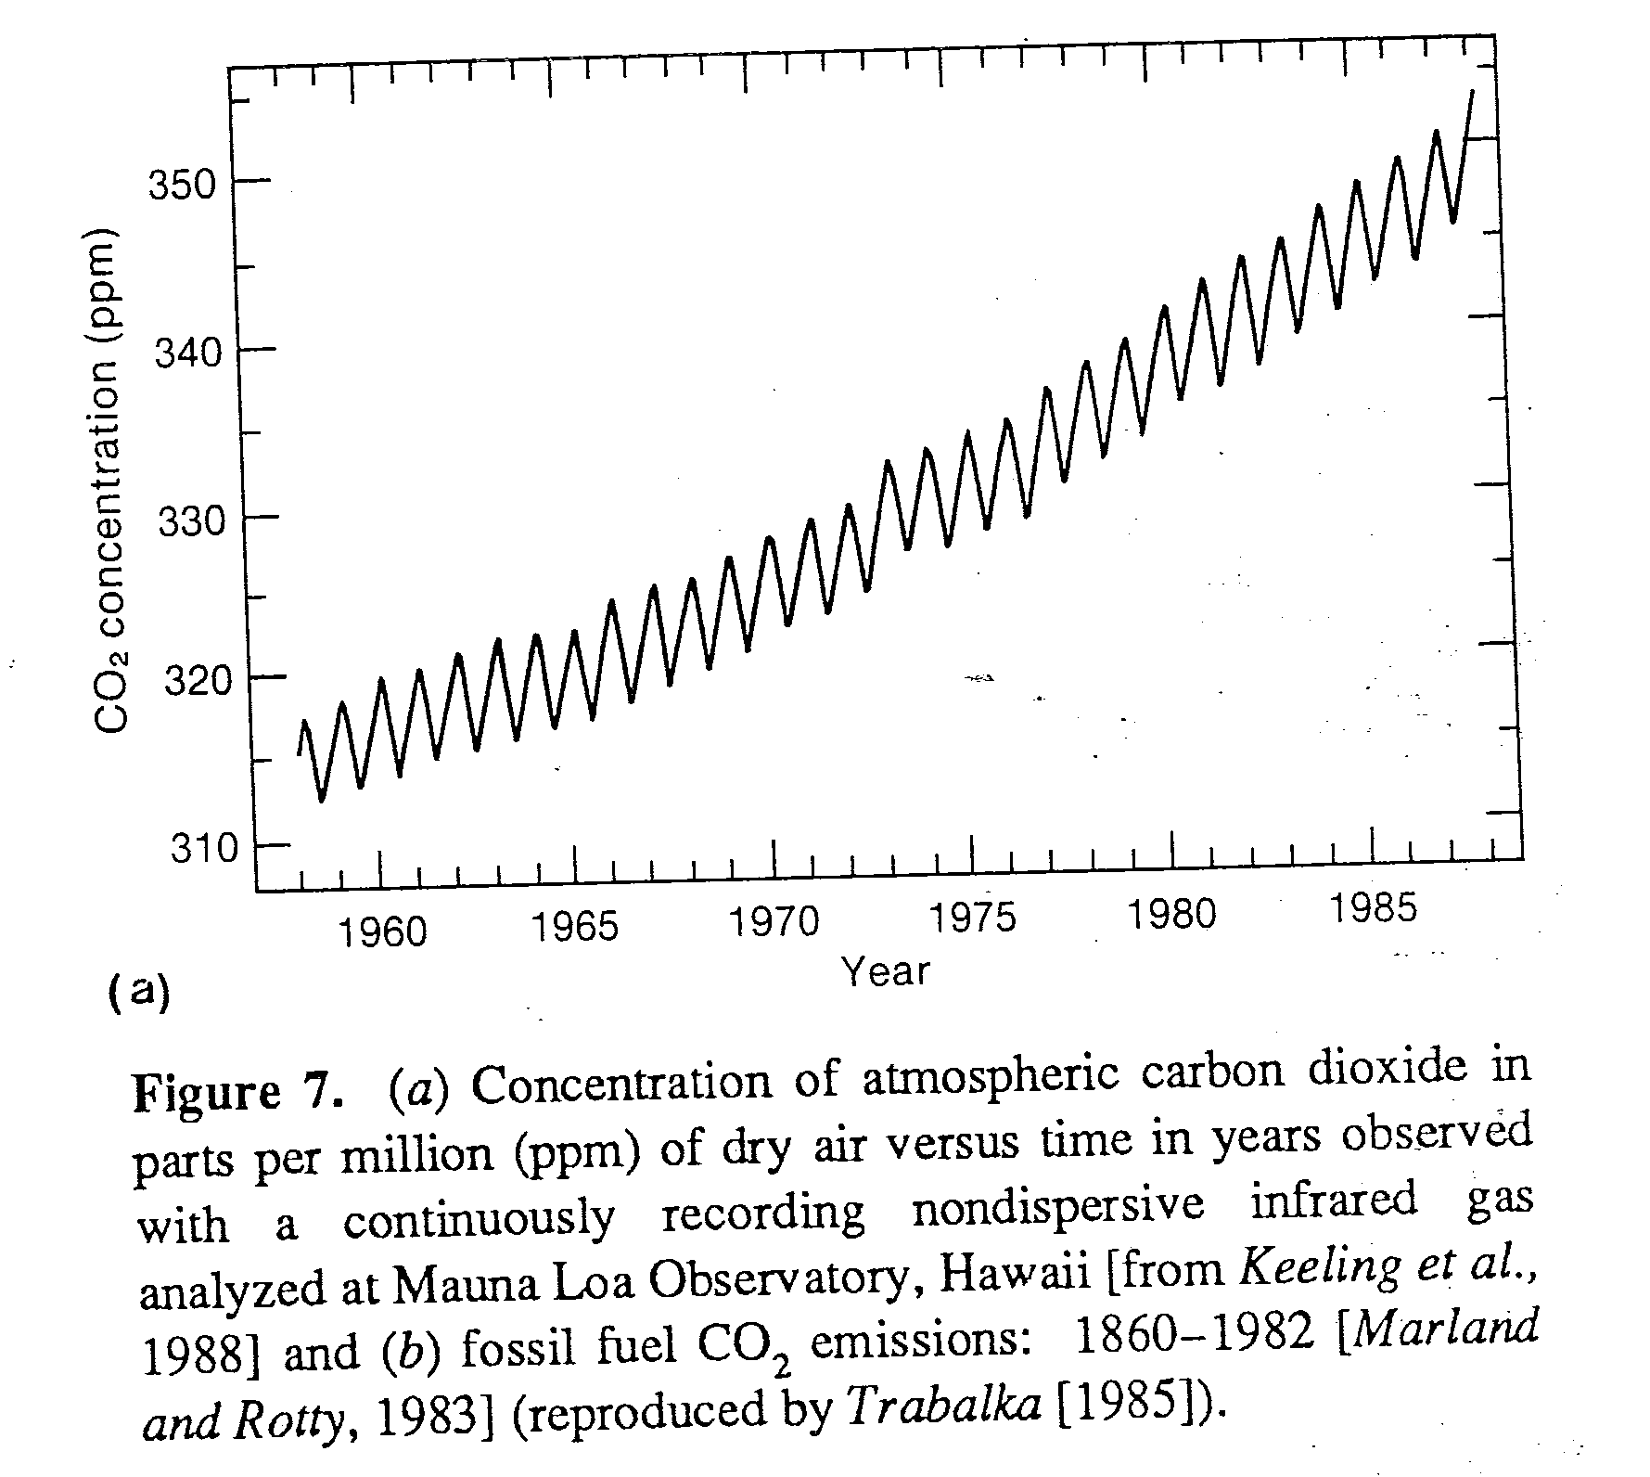
From Mitchell, Reviews of Geophysics, 1989

Slide 50
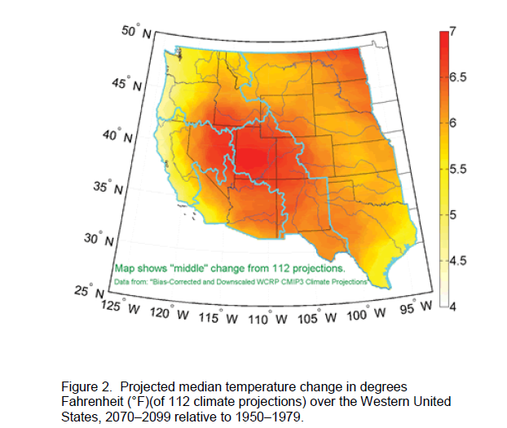
From: United States Bureau of Reclamation, (2011), "SECURE Water Act Section 9503(c) – Reclamation Climate Change and Water, Report to Congress," U.S. Department of the Interior, Bureau of Reclamation, Denver, Colorado, http://www.usbr.gov/climate/SECURE/docs/SECUREWaterReport.pdf.

Slide 51
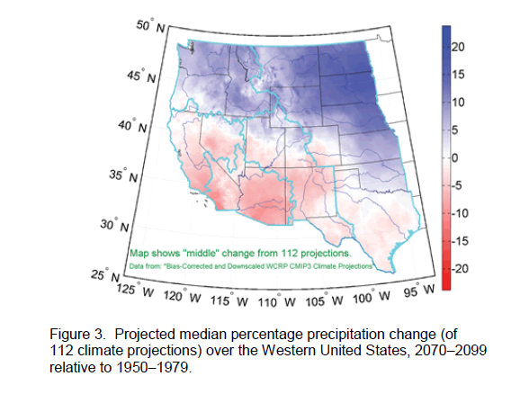
From: United States Bureau of Reclamation, (2011), "SECURE Water Act Section 9503(c) – Reclamation Climate Change and Water, Report to Congress," U.S. Department of the Interior, Bureau of Reclamation, Denver, Colorado, http://www.usbr.gov/climate/SECURE/docs/SECUREWaterReport.pdf.

Slide 52
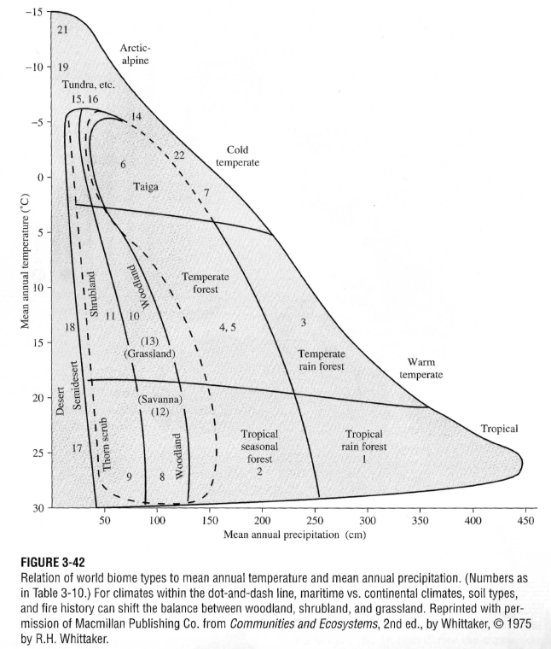
From Dingman, 2002

Slide 53
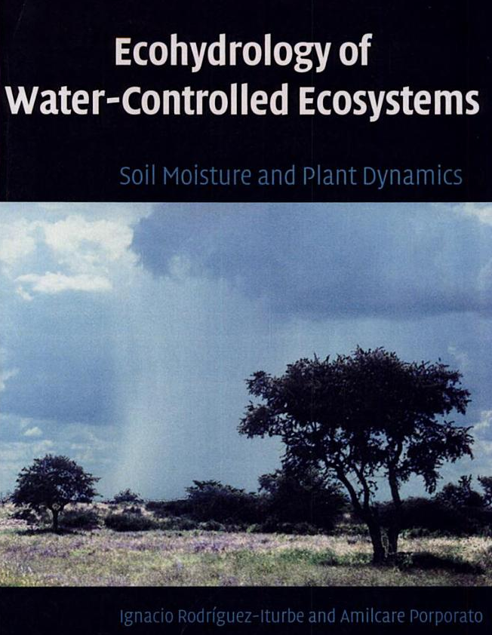
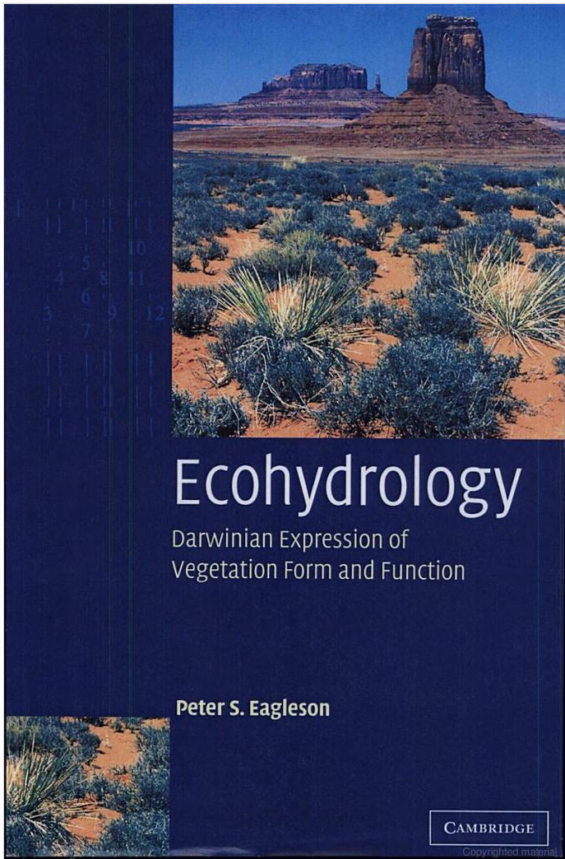
Eagleson, P. S., (2002), Ecohydrology, Darwinian Expression of Vegetation Form and Function, Cambridge University Press, 443 p.
Rodriguez-Iturbe, I. and A. Porporato, (2004), Ecohydrology of Water-Controlled Ecosystems, Cambridge University Press, 442 p.

